Slide 1
BUDGET SALES ANALYSIS

Slide 2
INTRODUCTION
PROBLEM STATEMENT
Our "Domain Sale" process is structured to help potential buyers purchase the domain they want immediately without the hassle of contacting the seller directly. A seller lists a domain for sale at a specific price in our Marketplace. An interested buyer sees this domain for sale and decides to buy it.
OBJECTIVE
The objective of the "Domain Sale" process project is to analyze the sales data, budget information, and variances in a structured and insightful manner to facilitate informed decision-making for both potential buyers and the business.

Slide 3
STEPS FOLLOWED IN DATA ANALYSIS –PYTHON
IMPORT NECESSARY LIBRARIES(NUMPY,PANDAS,MATPLOTLIB,SEABORN)
MERGING THE DATA- FROM EXCEL WORKBOOK
df1 = pd.merge(sales_df,product_df, on = 'ProductKey',how='inner’)
df2 = pd.merge(df1,customer_df, on = 'CustomerKey', how = 'inner’)
df = pd.merge(df2,territory_df, on = 'SalesTerritoryKey', how = 'inner’)
EXPLORATORY DATA ANALYSIS
NO OF ROWS=58189 NO OF COLUMNS=58
REMOVING THE DUPLICATE VALUES AND NULL VALUES

Slide 4
FEATURE ENGINEERING:
EXTRACTING FEATURES FROM ORDER DATE ( SALES_YEAR, SALES_MONTH, SALES_DAY, SALES_WEEK, SALES_DAY_NAME, ‘YEAR_MONTH’
NEW FEATURES:
TOTAL_INVOICE_AMNT = SALES_AMOUNT + TAX_AMOUNT
PROFIT = UNITE PRICE * ORDER_QTY – TOTAL_PRODUCT_COST
REPLACING THE ‘ , ‘ TO ‘ – ‘ IN PRODUCT NAME FEATURE

Slide 5
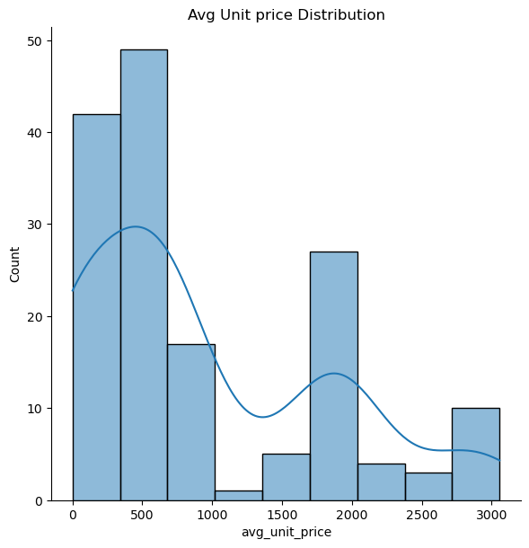
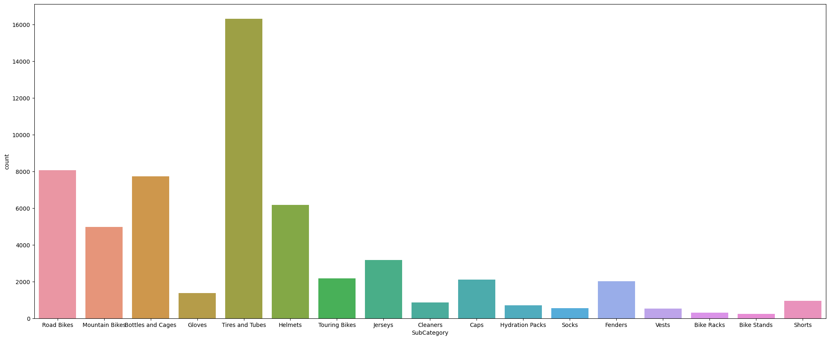
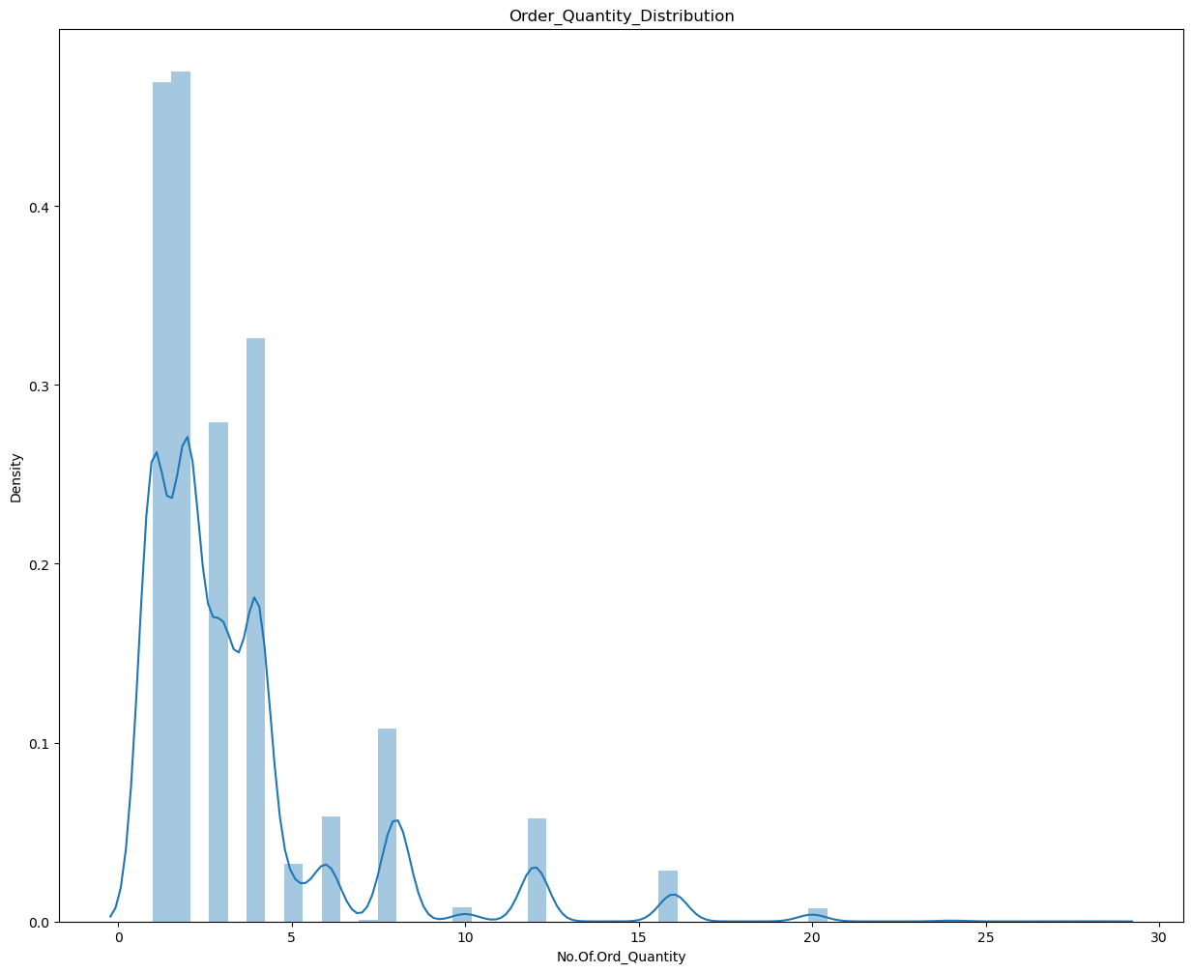
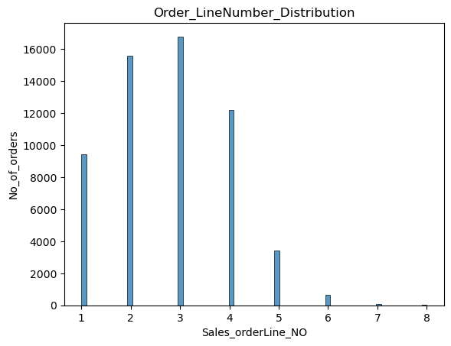
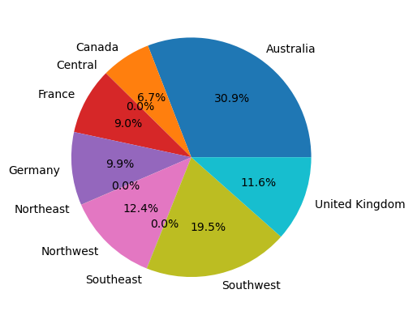
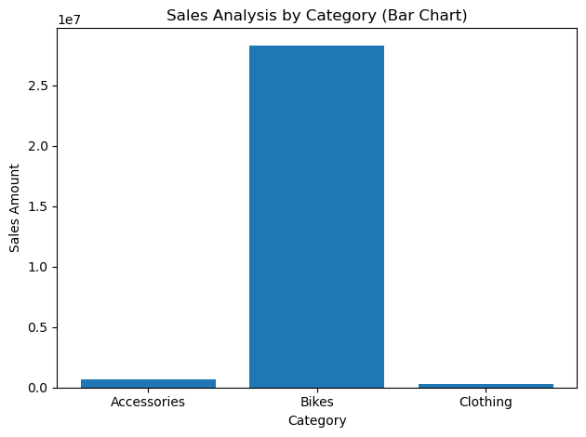
VISUALIZATION ANALYSIS

Slide 6
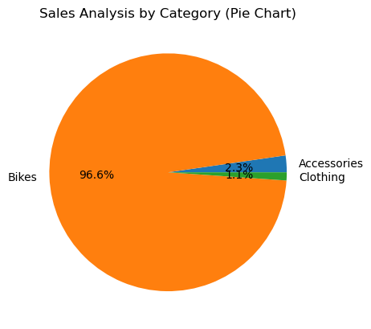
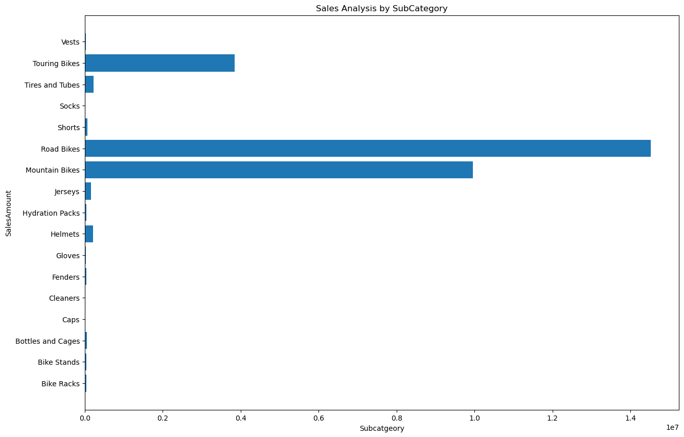
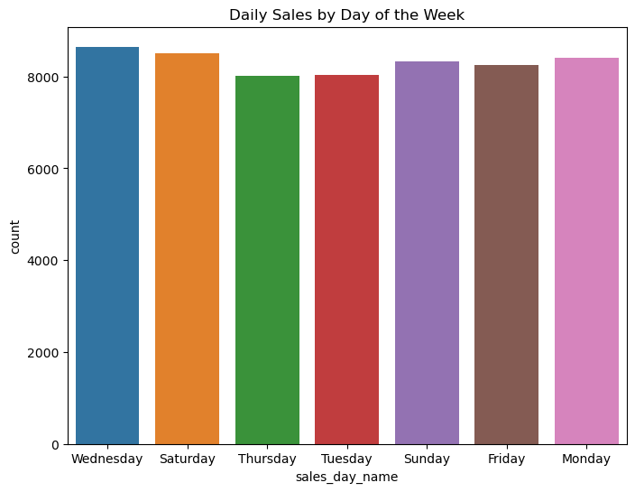
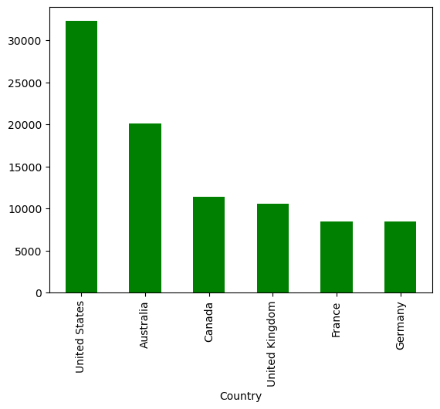
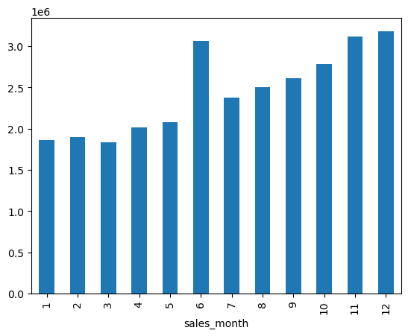
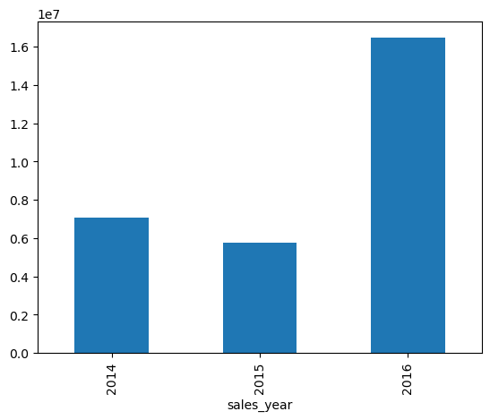
VISUALIZATION ANALYSIS

Slide 7
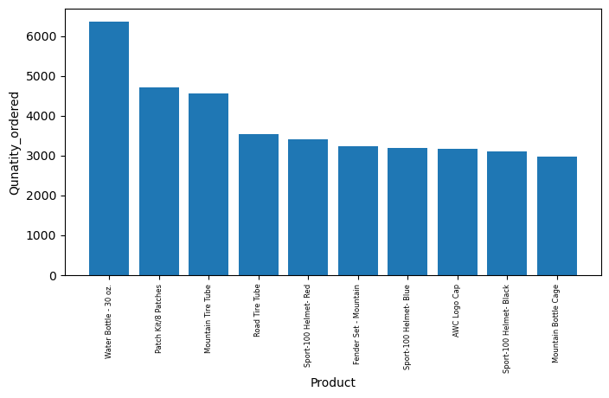
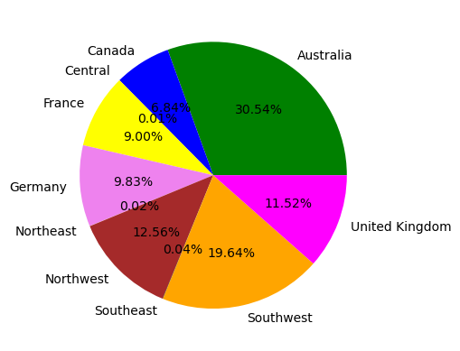
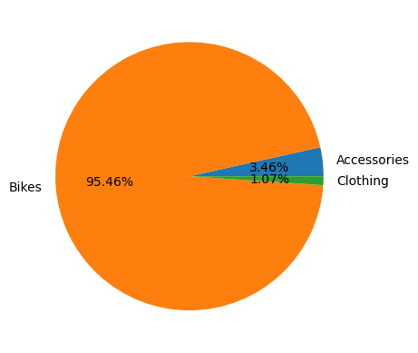
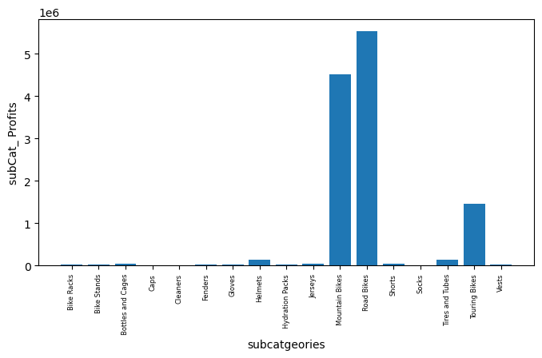
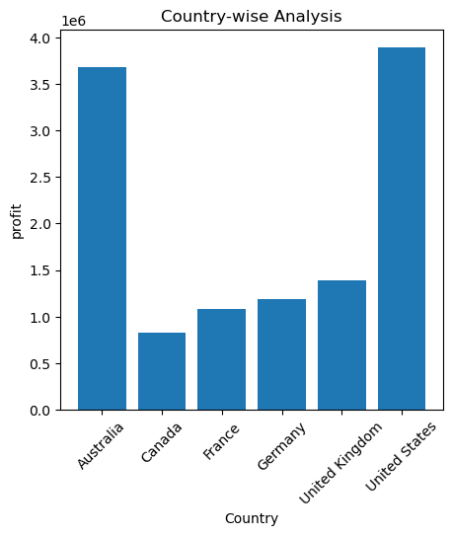
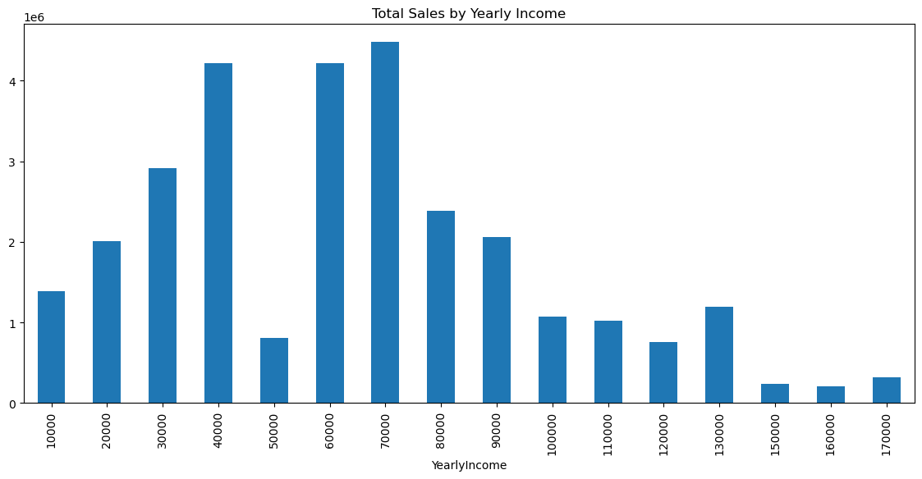

Slide 8
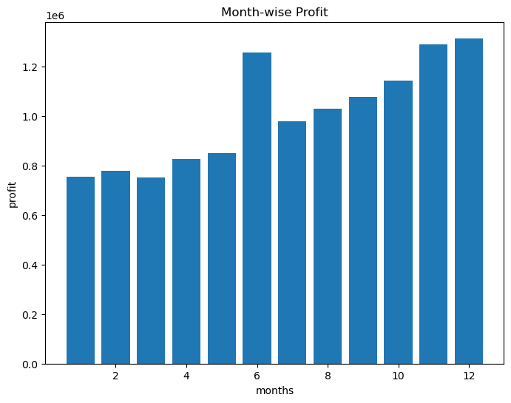
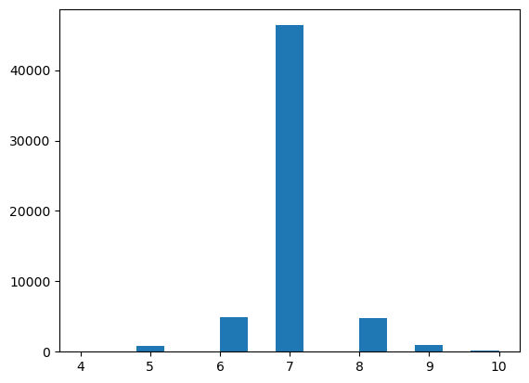
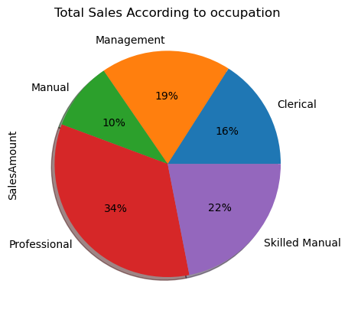
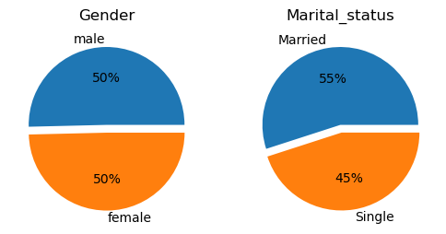
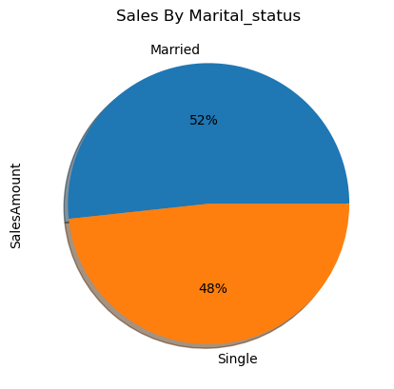

Slide 9
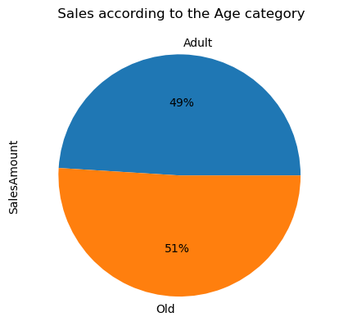
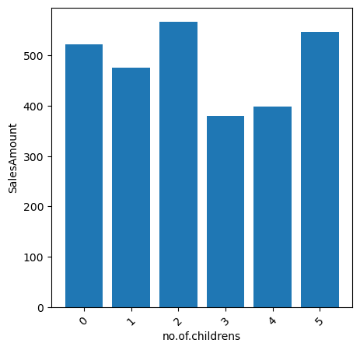
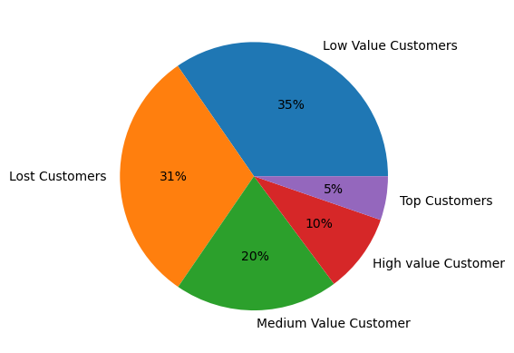
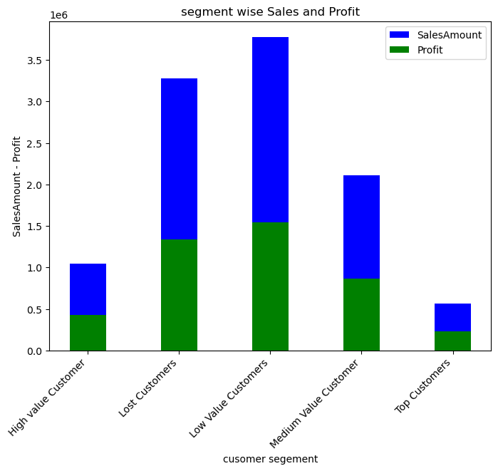

Slide 10
KEY PERFORMANCE INDICATORS
Distribution of customers and sales with respect to Countries.
Distribution of sales with respect to the product category.
Distribution of sales with respect to the product sub-category.
Distribution of sales with respect to the yearly income of the customers.
Budget distribution with respect to product category and sub-category.

Slide 11
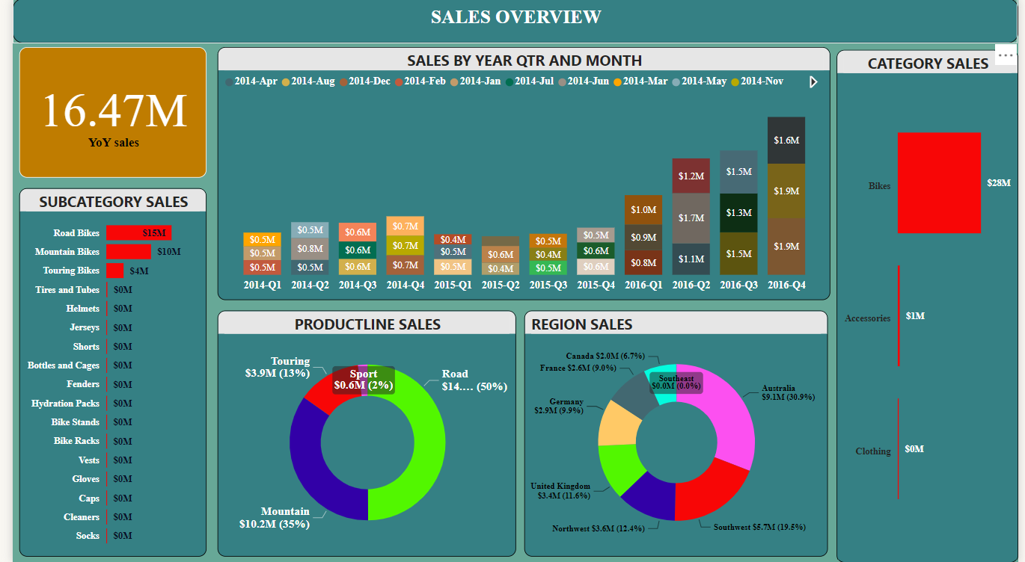
POWER BI DASHBOARD ANALYSIS

Slide 12
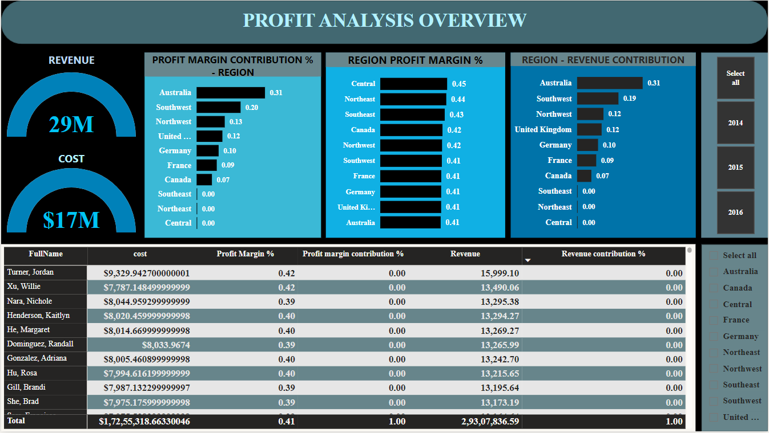

Slide 13
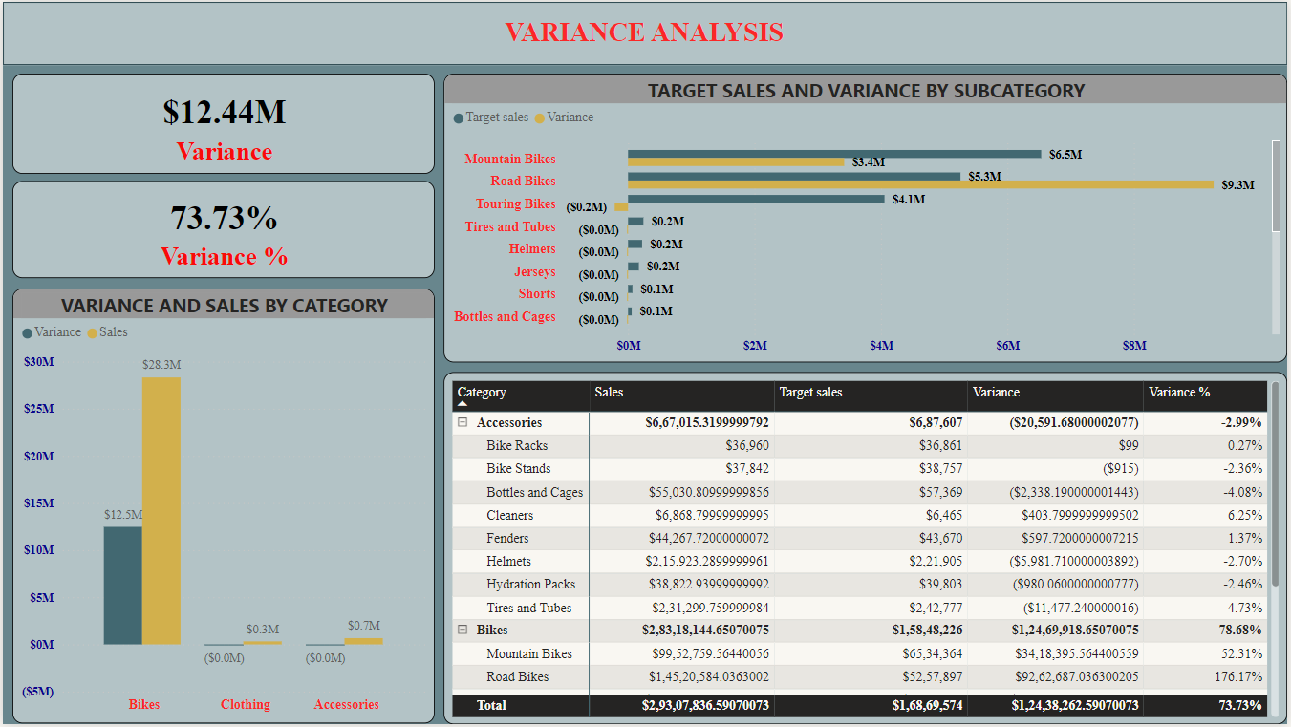

Slide 14
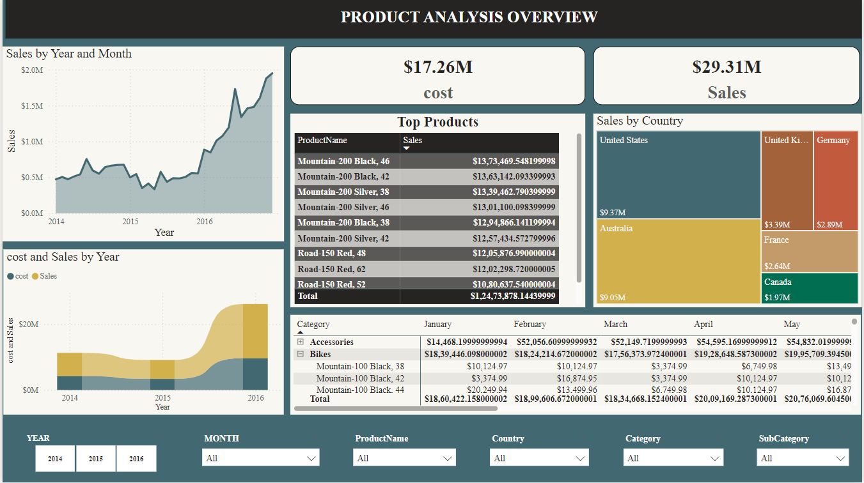

Slide 15
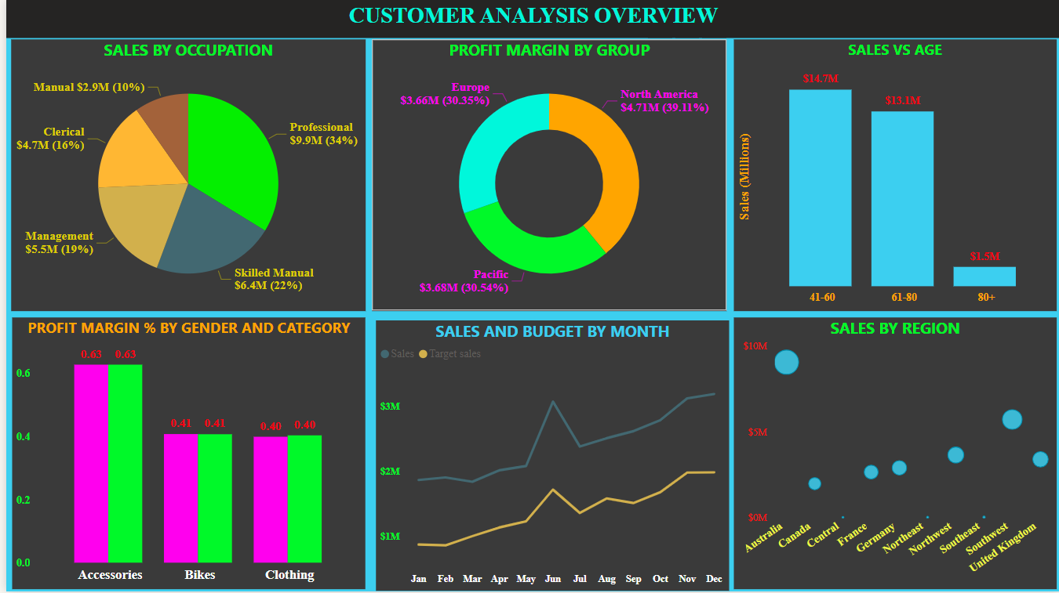

Slide 16
OBSERVATIONS:﻿
Target sales and total Variance are positively correlated with each other.
Mountain Bikes accounted for 38.73% of Target sales.
﻿Target sales and Variance diverged the most when the sub-category was Touring Bikes. when Target sales were higher than Variance.﻿﻿
﻿﻿﻿2016-Q4 in Year-Month 2016-Dec made up 6.65% of Sales.﻿﻿
﻿﻿﻿﻿Road Bikes had the highest Sales and were 25% higher than Socks, which had the lowest Sales.
﻿﻿﻿﻿Road Bikes accounted for 49.55% of Sales.﻿﻿
The company has experienced a significant increase in both profit and sales throughout the year 2016.
Gender and Marital status distribution of customers is more or less the same.
Australia had the highest Profit margin contribution % higher than Central, which had the lowest Profit margin contribution % at 0.00.﻿﻿
﻿Sales (132.94% increase) and cost (128.40% increase) both trended up between 2014 and 2016.﻿﻿
﻿﻿﻿﻿﻿﻿﻿﻿﻿﻿Sales were unexpectedly high in June 2016﻿﻿
﻿﻿﻿Sales had the most significant anomaly in June 2016.﻿﻿
﻿﻿Sales experienced the longest period of growth between October 2015 and December 2016.﻿﻿﻿

Slide 17


THANK YOU
KABILAN G
g.kabilan227@gmail.com

